Slide 1



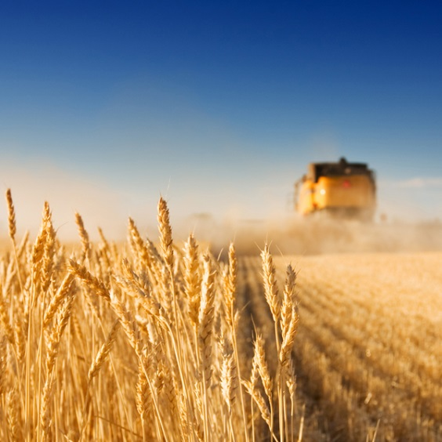
Quantifying the environmental and economic impacts of feeding China’s monogastric livestock with food waste: a general equilibrium approach
Weitong Long¹, Xueqin Zhu¹, Hans-Peter Weikard¹, Oene Oenema², Yong Hou³
¹Wageningen University, ²Wageningn Environmental Research, ³China Agricultural University
29th EAERE Conference, Belgium
Jul 3, 2024

Slide 2


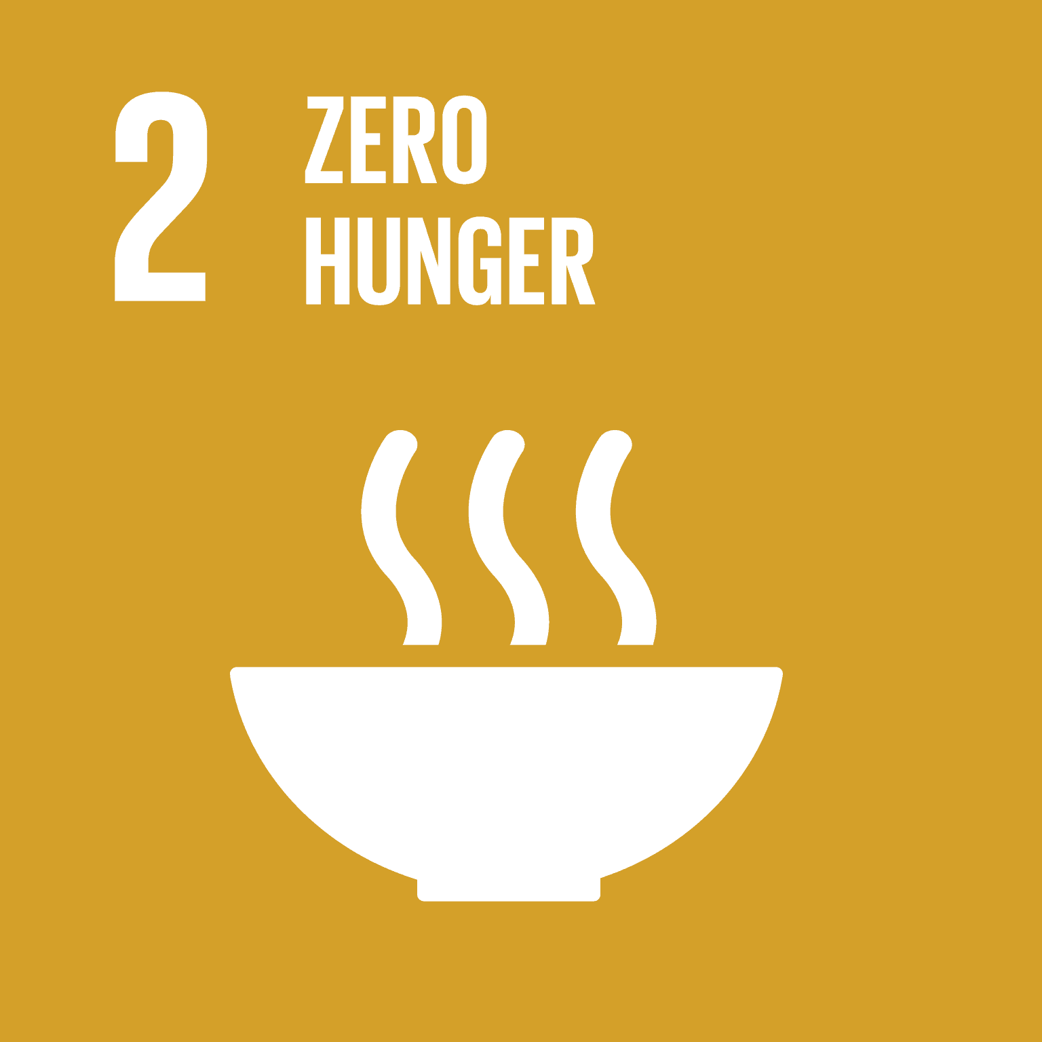







Motivation: Feeding animals with food waste
1.3 billion tonnes of global food waste drive greenhouse gas (GHG) emissions
Around 1.3 billion tonnes of food waste are produced in the world, which are mainly disposed in landfills and incinerators, and are a significant source of greenhouse gas (GHG) emissions (Gustavsson et al., 2011).
Environmental benefits of feeding animals with food waste
Feeding animals with food waste can possibly reduce GHG emissions, mitigate land pressures, and alleviate food-feed competition (Van Zanten et al., 2018; Van Hal et al., 2019; Fang et al., 2023).
Contribution to Sustainable Development Goals (SDGs)
It may to achieving Sustainable Development Goals (SDGs), including SDG 2 (zero hunger), SDG 6 (clean water and sanitation), SDG 12 (responsible consumption and production), SDG 13 (climate action), and SDG 15 (life on land) (UN, 2025).
Indirect and spillover effects not covered in previous studies
Rebound effect: Lower feed costs may expand livestock production and increase emissions. Broader Impact: Knock-on effects on other commodities may alter expected environmental benefits. Economic impact: Ignoring income effects may bias conclusions on food affordability.
Why China?
46% of global pork production
34% of global egg production
13% of global poultry meat production
30% of food produced is wasted
Motivation
Method and data
Results
Conclusions

Slide 3



Research questions
What has been studied for feeding animals with food waste?
Environmental benefits of feeding animals with food waste (e.g. Van Zanten et al., 2018; Van Hal et al., 2019; Fang et al., 2023).
What is missing in studies for feeding animals with food waste?
Impact on livestock production, food supply, and other sectors
Economy-wide emissions of GHGs, acidification, and eutrophication pollutants
Food security (i.e., food availability and affordability)
What are the environmental and economic impacts of upcycling food waste in China’s monogastric livestock production?
Motivation
Method and data
Results
Conclusions

Slide 4
Applied general equilibrium models with food waste
Production
Food waste recycling service
Food waste collection service
Recycled food waste as animal feed
Cereals
Vegetables & fruits
Roots & tubers
Oilseeds & pulses
Recycling
Collection
Incineration
Landfill
Sugar
crops
Other
crops
Ruminant livestock
Monogastric livestock
Cereal
bran
Alcoholic pulp
Oil
cake
Compound feed
Other
food
Nitrogen fertiliser
Phosphorous fertiliser
Fish
Non-food
Food waste generation
Goods
Food waste:
Cereals waste
Vegetables & fruits waste
Roots & tubers waste
Oilseeds & pulses waste
By-product waste:
Cereal bran waste
Alcoholic pulp waste
Oil cake waste
Consumption
Households
Food waste
By-product waste
The consumer price of food includes both the market price of food and the cost of collecting food waste by the municipality.
Motivation
Method and data
Results
Conclusions

Slide 5
The current food waste utilisation in China
 | Total amount (Tg) | Used as feed (%) | Unused biomass (%)
Cereals waste | 36.09 | 39% | Landfill (40%) & incineration (21%)
Vegetables & fruits waste | 175.01 | 39% | Landfill (40%) & incineration (21%)
Roots & tubers waste | 13.32 | 39% | Landfill (40%) & incineration (21%)
Oil seeds & pulses waste | 1.27 | 39% | Landfill (40%) & incineration (21%)
Cereal bran | 31.34 | 36% | Landfill (42%) & incineration (22%)
Alcoholic pulp | 42.34 | 16% | Landfill (55%) & incineration (29%)
Oil cake | 84.66 | 72% | Landfill (18%) & incineration (10%)

Slide 6
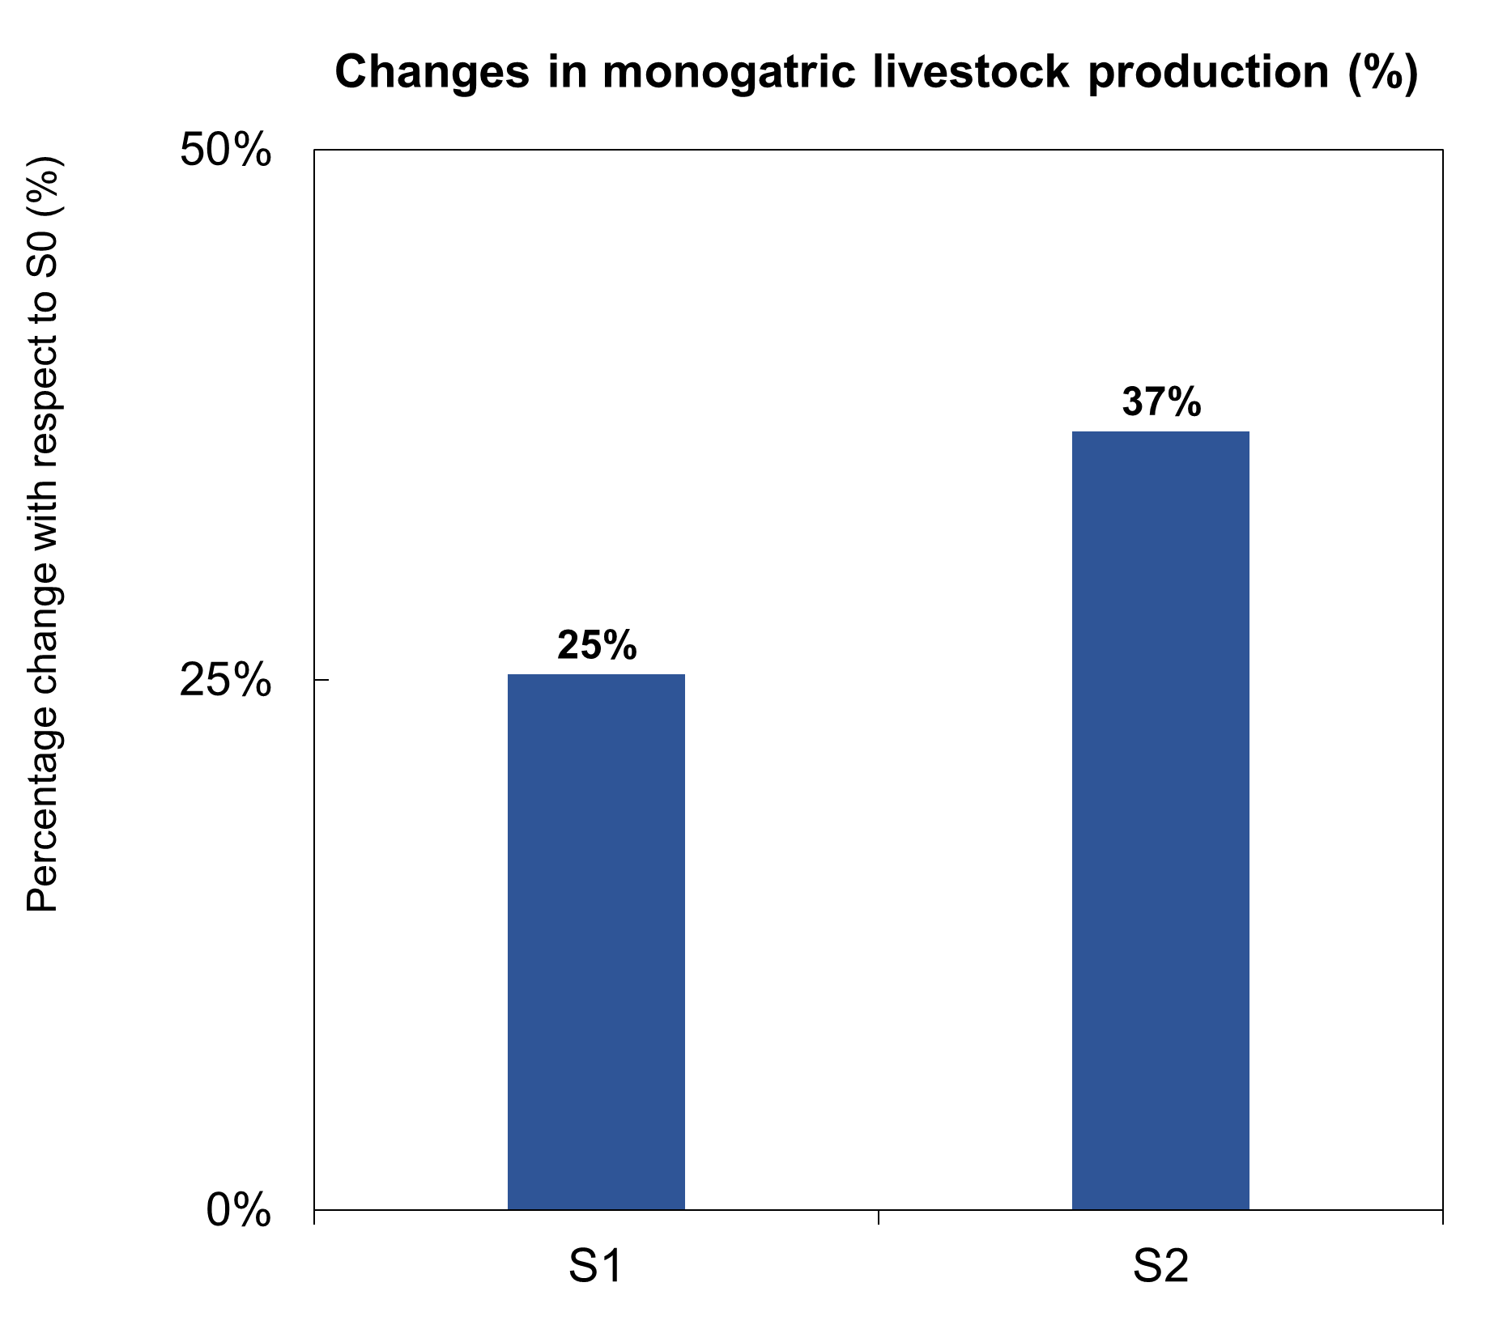
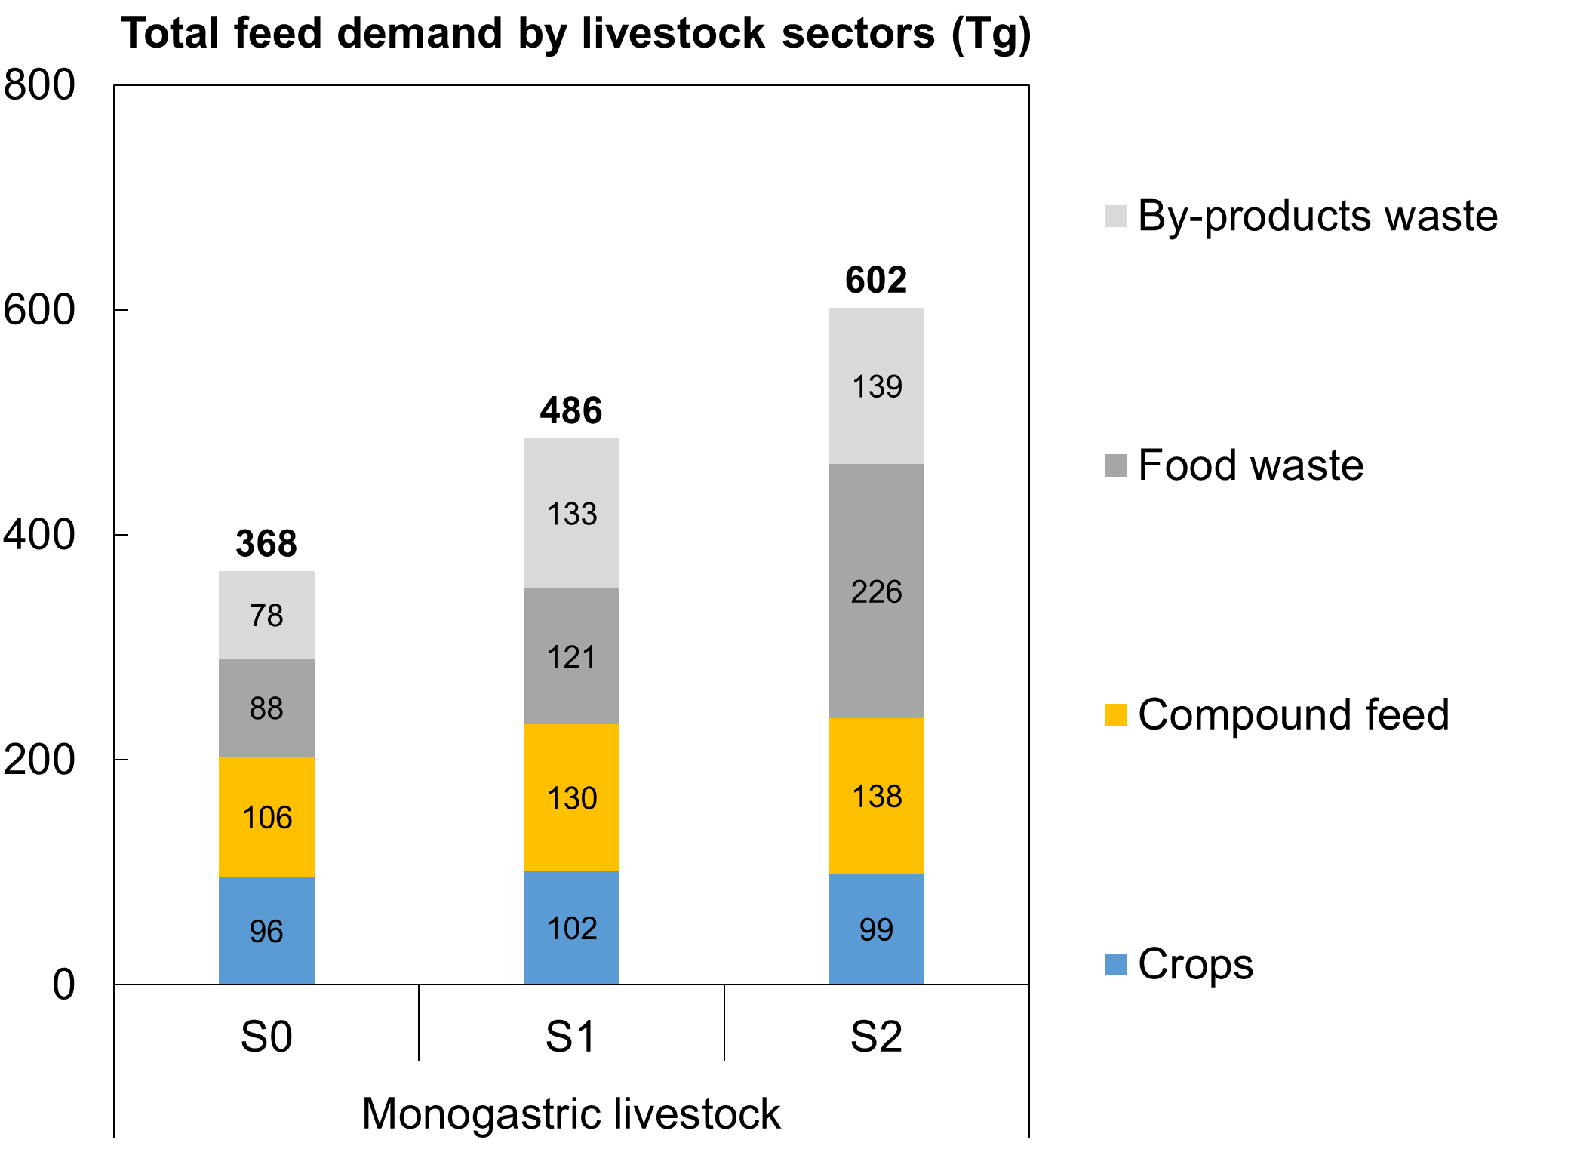
Expanded monogastric livestock production will reverse the substitution of human-edible feed crops for per animal output
Expand Livestock production: Upcycling food waste as feed reduced feed costs and increased profits, driving a 25-37% rise in monogastric livestock production.
Feed Demand Increase: This expansion caused a 9.5-9.9% surge in total demand for human-edible feed crops as feed.
Providing 18-28% more feed protein and 22-69% more feed energy
S1: Allowing partial use of food waste as feed
S2: Allowing full use of food waste as feed
Motivation
Method and data
Results
Conclusions

Slide 7
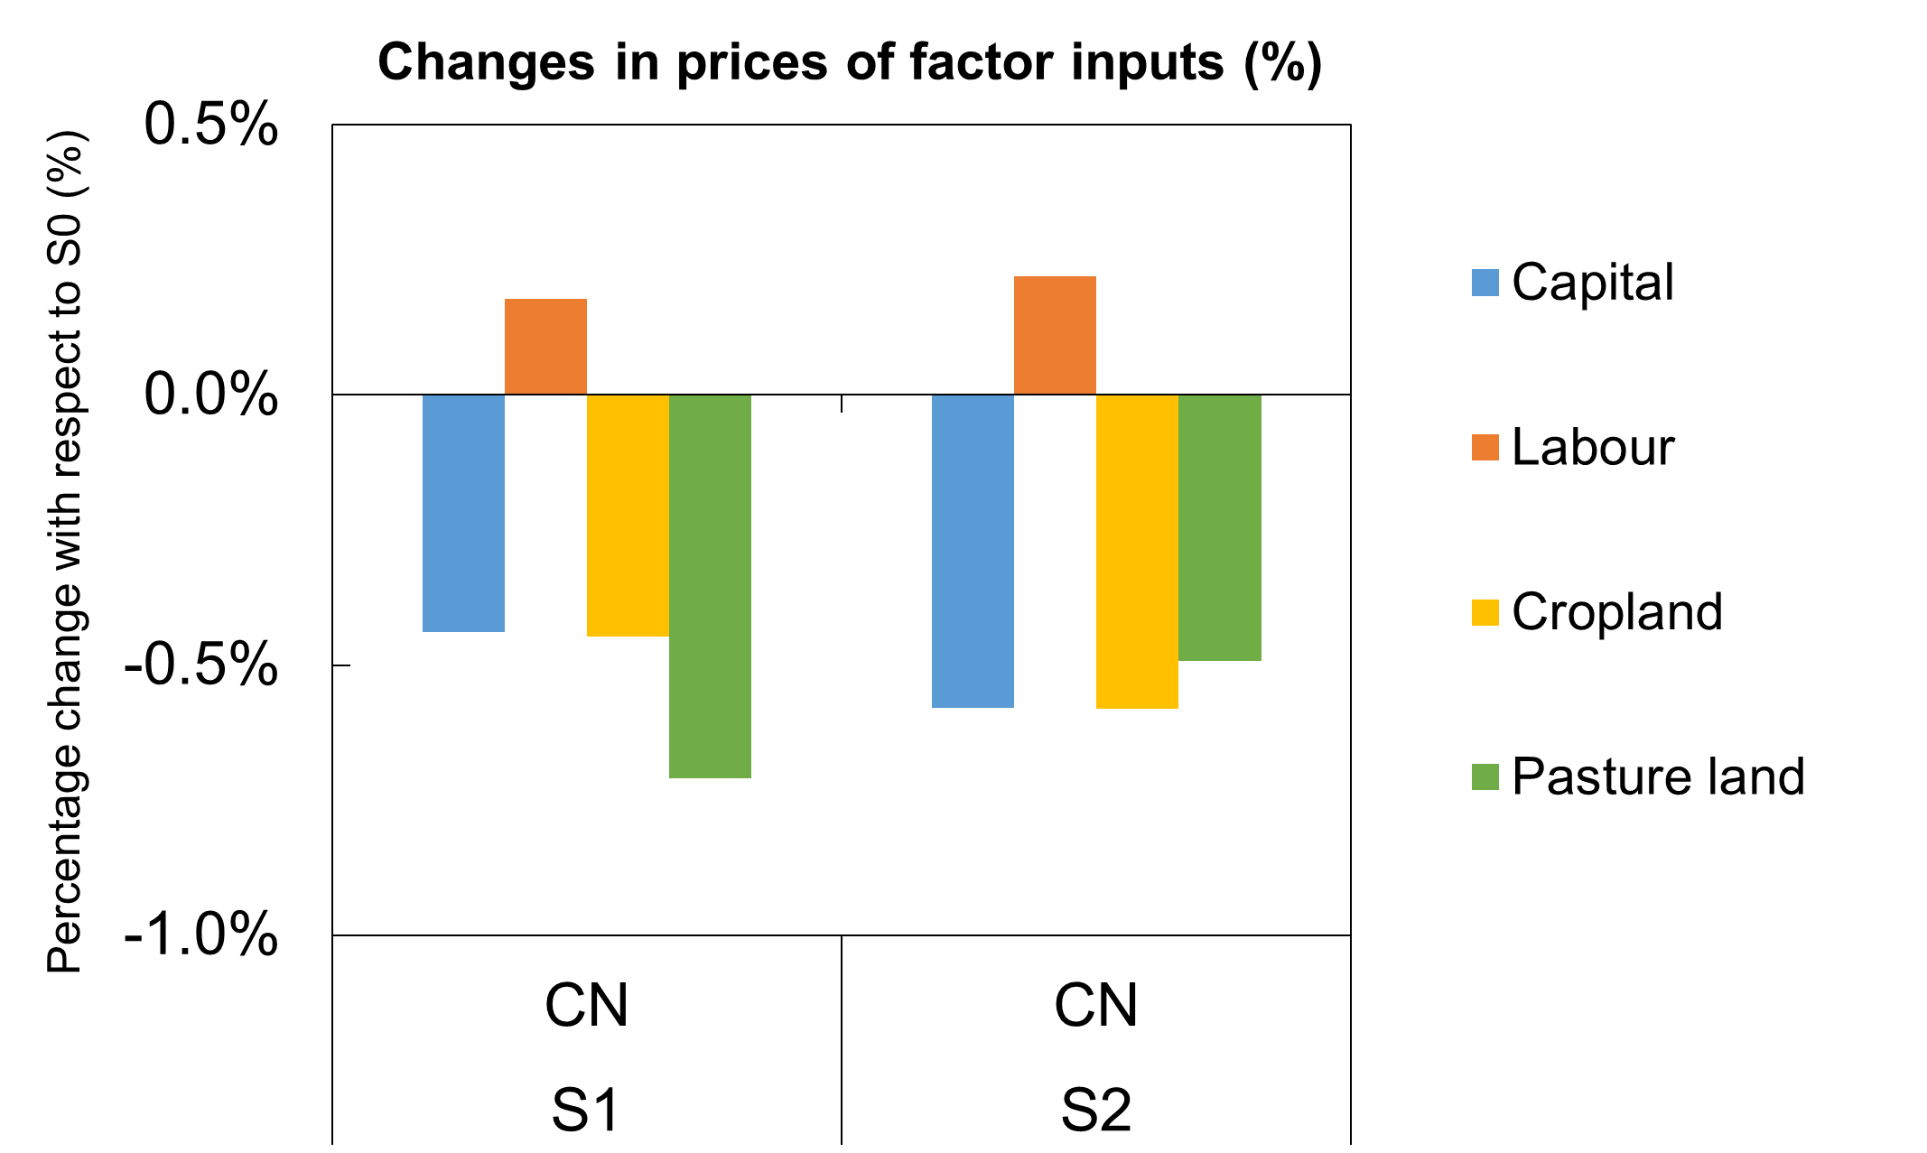
Expanded monogastric livestock production will lead to the substitution of labour with other relatively cheaper factor inputs
Wage Boost: Expanded livestock production raised the average wage across the Chinese economy by 0.18-0.22%.
Labour Substitution: Producers may substitute labour with other relatively cheaper factor inputs (i.e., capital, cropland, and pastureland).
S1: Allowing partial use of food waste as feed
S2: Allowing full use of food waste as feed
Motivation
Method and data
Results
Conclusions

Slide 8
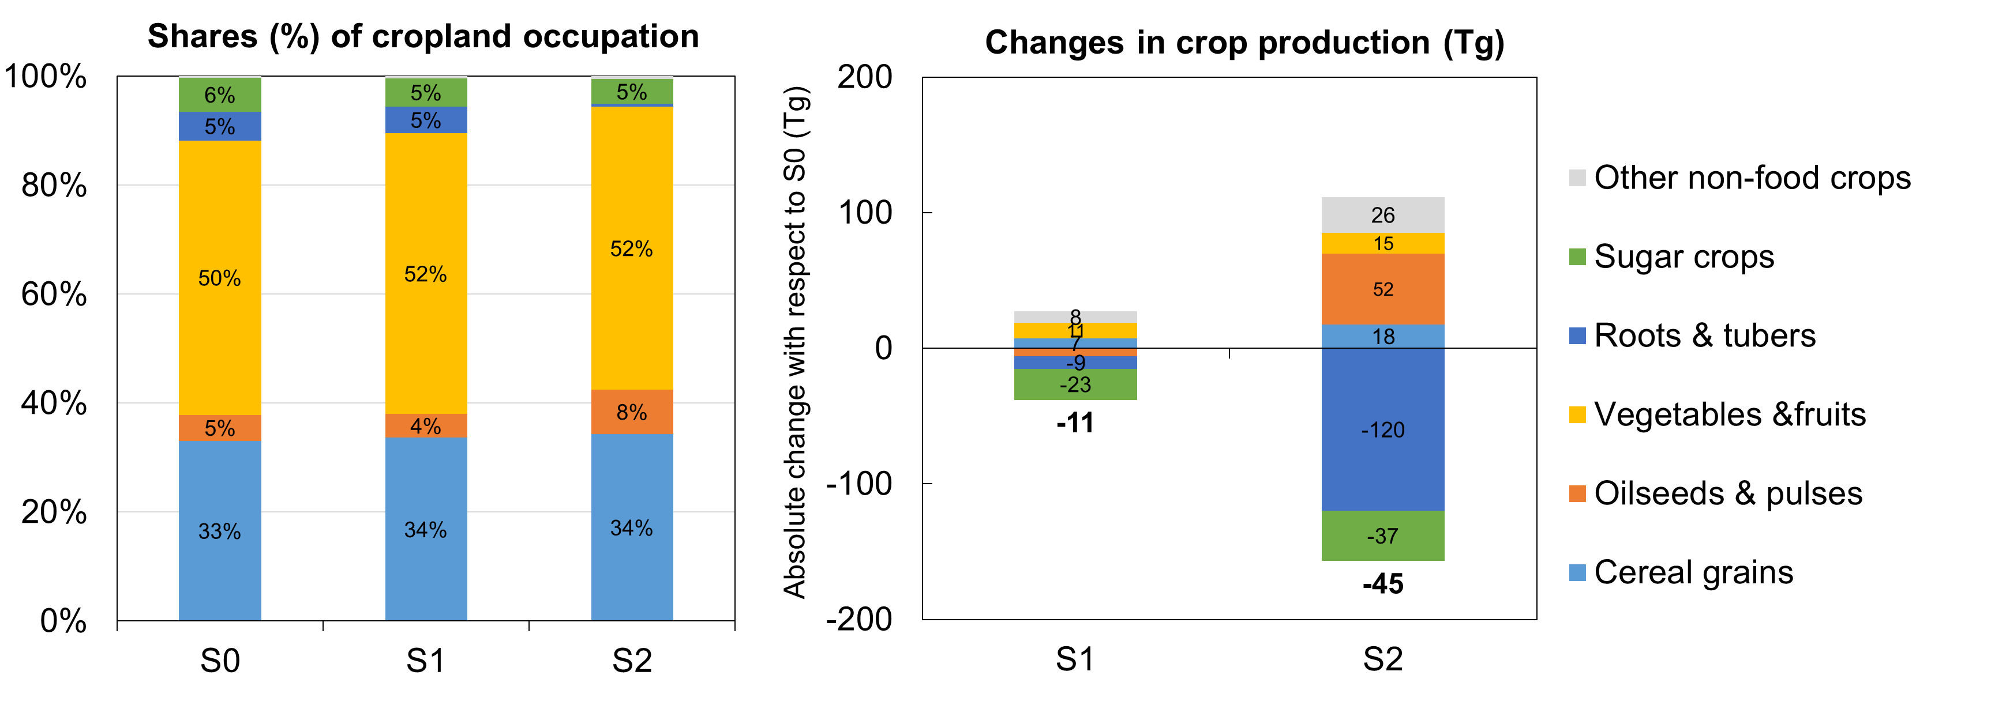
The substitution of labour with other factor inputs has varying impacts on different types of crop production
Crop Priority Shift: Crop producers will reduce the production of labour-intensive crops, such as roots & tubers (7-90%) and sugar crops (17-27%).
Cropland Reallocation: Saved cropland will be used for increasing the production of cereal grains (1-3%), vegetables & fruits (2-3%), and other non-food crops (34-105%).
Oilseeds & Pulses Production: Oilseeds & pulses production will decrease by 8% with partial food waste use as feed, but increase by 71% with full use.
→ to choose the cheapest combination of inputs
S1: Allowing partial use of food waste as feed
S2: Allowing full use of food waste as feed
Motivation
Method and data
Results
Conclusions

Slide 9
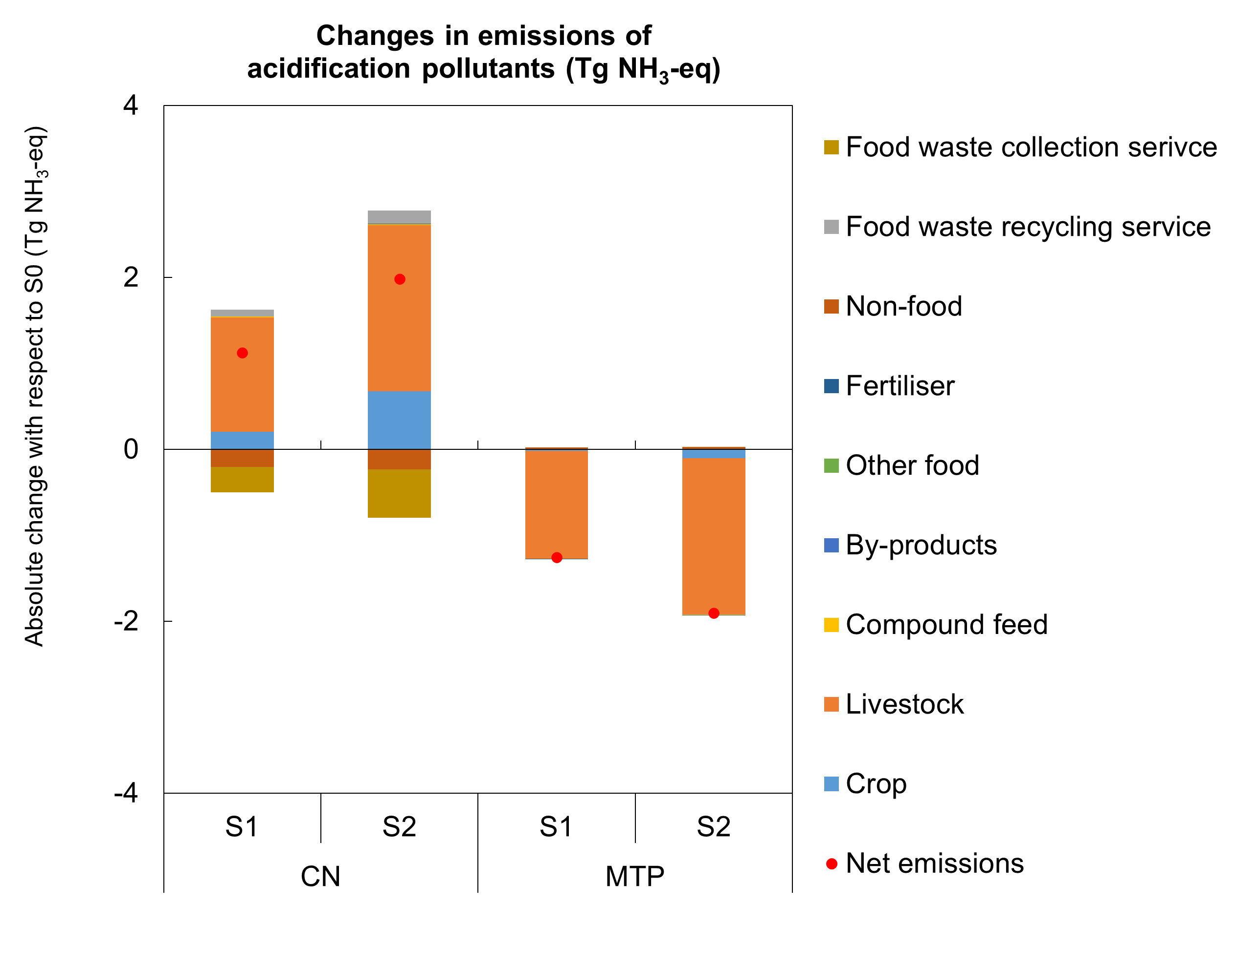
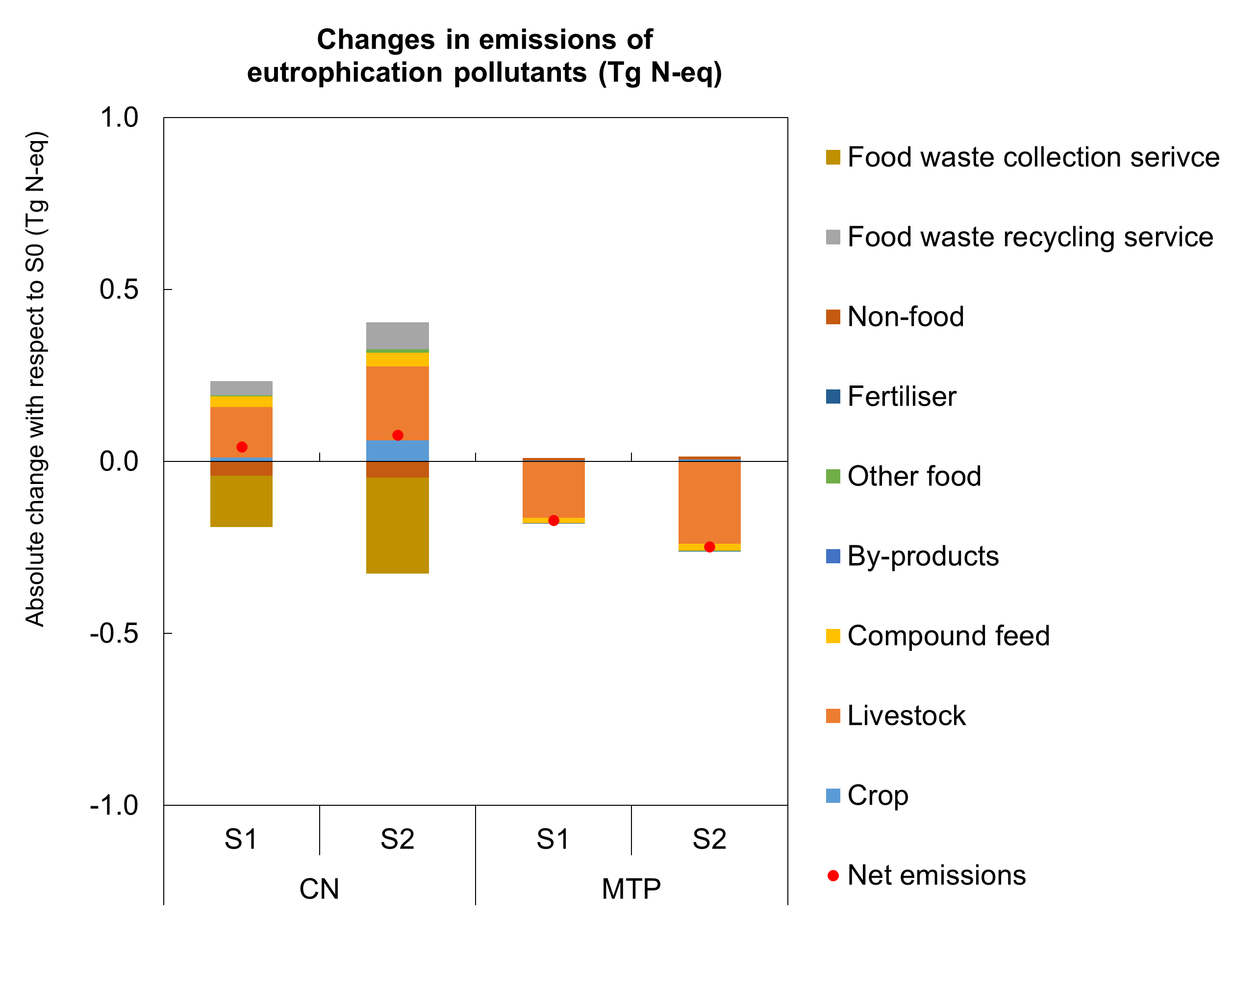
Negative environmental spillovers in emissions of acidification and eutrophication pollutants in China
Environmental spillovers in China: Expanded monogastric livestock production increased economy-wide emissions of acidification (3-6%) and eutrophication (0.5-0.8%) pollutants.
Trading Partners' Environmental Gains: China's main food and feed trading partners (MTP, e.g., Brazil, US, Canada) saw reduced economy-wide emissions of acidification (9-14%) and eutrophication pollutants (3-4%) by saving domestic livestock production.
S1: Allowing partial use of food waste as feed
S2: Allowing full use of food waste as feed
Motivation
Method and data
Results
Conclusions

Slide 10
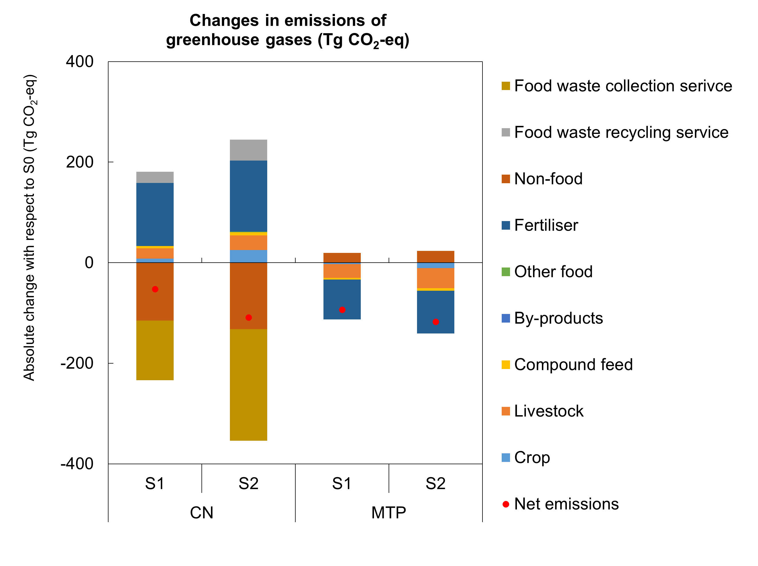
Greenhouse gases (GHG) emissions reduction in China
GHGs Reduction in China: Economy-wide GHG emissions decreased by 0.5-0.9%, primarily due to less food waste in landfills and incinerators, and contracted non-food production.
Trading Partners' Environmental Gains: MTP reduced economy-wide GHG emissions (1.2-1.5%) by saving domestic production of livestock and fertiliser.
S1: Allowing partial use of food waste as feed
S2: Allowing full use of food waste as feed
Motivation
Method and data
Results
Conclusions

Slide 11
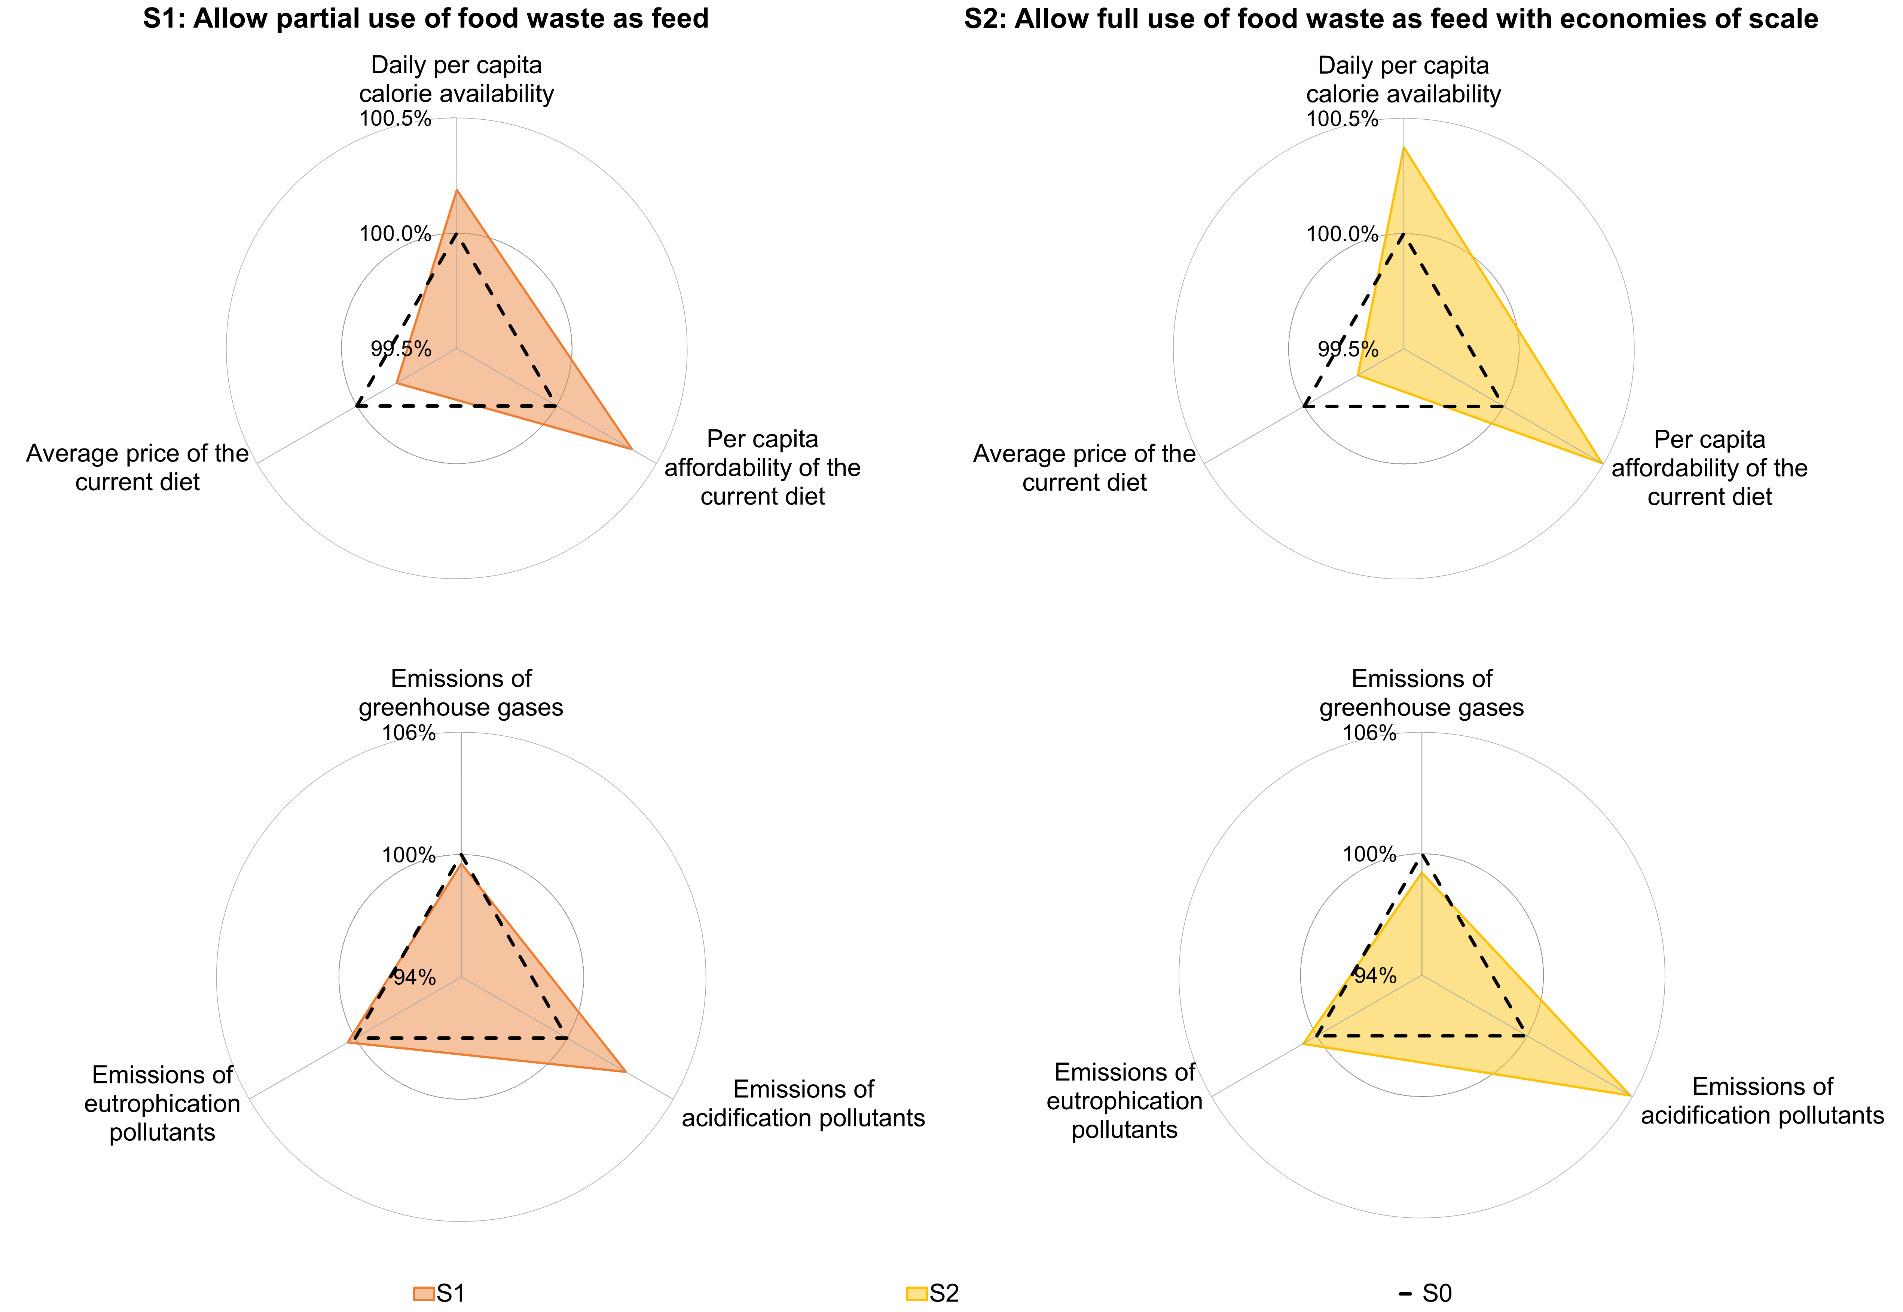
The asymmetric impacts on food security and environment sustainability
Better food security
Improved food availability (0.19-0.37%)
Improved food affordability (0.38–0.49%)
Reduced food price (0.20-0.27%)
Worse environment sustainability
Decreased GHG emissions (0.5-0.9%)
Increased emissions of acidification (3-6%) and eutrophication (0.5-0.8%) pollutants
S1: Allowing partial use of food waste as feed
S2: Allowing full use of food waste as feed
Motivation
Method and data
Results
Conclusions

Slide 12
Conclusions
Impact on Livestock Production and Wage: Upcycling 54-100% of food waste as feed increased monogastric livestock production by 25-37% and the average wage across the Chinese economy by 0.18-0.22%.
Negative Environmental Spillovers: Increased Chinese economy-wide emissions of acidification (3-6%) and eutrophication (0.5-0.8%) pollutants due to expanded monogastric livestock production.
GHGs Reduction: Synergy effects from less food waste in landfills and incinerators, alongside contracted non-food production, decreased Chinese economy-wide GHG emissions by 0.5-0.9%.
Asymmetric Impacts on Food Security and Environment Sustainability: Feeding food waste strategies increased food availability (6-12 kcal capita⁻¹ day⁻¹) and affordability (0.38-0.49%) in China but slightly reduced food availability (0.5-1.0 kcal capita⁻¹ day⁻¹) and increased affordability (0.18-0.22%) in its trading partners.
Motivation
Method and data
Results
Conclusions

Slide 13
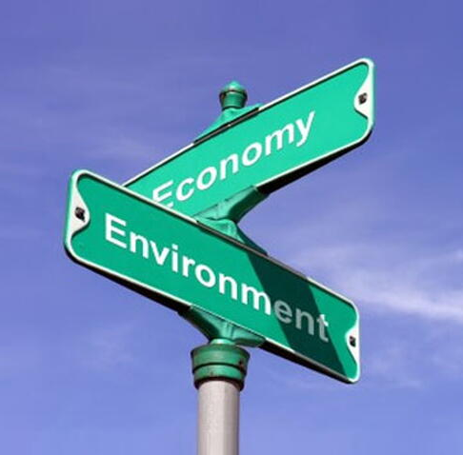



Thank you!
Questions?
Contact me via
weitong.long@wur.nl
@WeitongLong
linkedin.com/in/weitong-long-422714106

Slide 14
Key assumptions used in the scenarios
We will maintain the same protein and energy intake for per unit of animal output in all scenarios.
Scenarios ª | Food waste as animal feed in its total supply | Detailed explanation
S0: Baseline | Food waste: 39% By-products: 51%
S1: Allowing partial use of food waste as feed | Food waste: 54% By-products: 100% | Expanding the “food waste recycling service” sector to achieve this goal.
S2: Allowing full use of food waste as feed with economies of scale | Food waste: 100% By-products: 100% | Expanding the “food waste recycling service” sector to achieve this goal. A 1% increase in recycling waste will give a 0.078% increase in the costs of recycling waste (Cialani and Mortazavi, 2020).
→ Cross-provincial transportation of food waste is not allowed
→ Cross-provincial transportation of food waste is allowed
Motivation
Method and data
Results
Conclusions

Slide 15






What are monogastric and ruminant livestock?
Feed ratio
Monogastric livestock
Pigs
Laying hens
Broilers
Ruminant livestock
Dairy cows
Other cattle
Sheep & goat
(Cheng et al., 2022, Nature Food)

